Slide 1

MICHELIN STAR RESTAURANTS
DSF2
LIM KUAN HWEE SEAN
JEONG DOHYUN
Notes:
Hi professor Ju Chang,
We are lab group dsf2 a 2 member group consisting of jeong dohyun and myself sean lim
We have separated the tasks where dohyun was in charge of data cleaning and machine learning. The conclusions and findings are done separately
I am in charge of exploratory data analysis, data cleaning and preparation as well as making the slides, video and uploading onto github.
To begin we we will be presenting our mini-project on michelin star restaurants

Slide 2
Table of contents
03
01
Core Analysis
Practical Motivation
Data Set Presentation
02
Conclusion
04
Data Set Used
Problem Definition
Machine Learning Model
Tackling the problem
Exploratory Data Analysis
Cleaning of Data Set

Slide 3
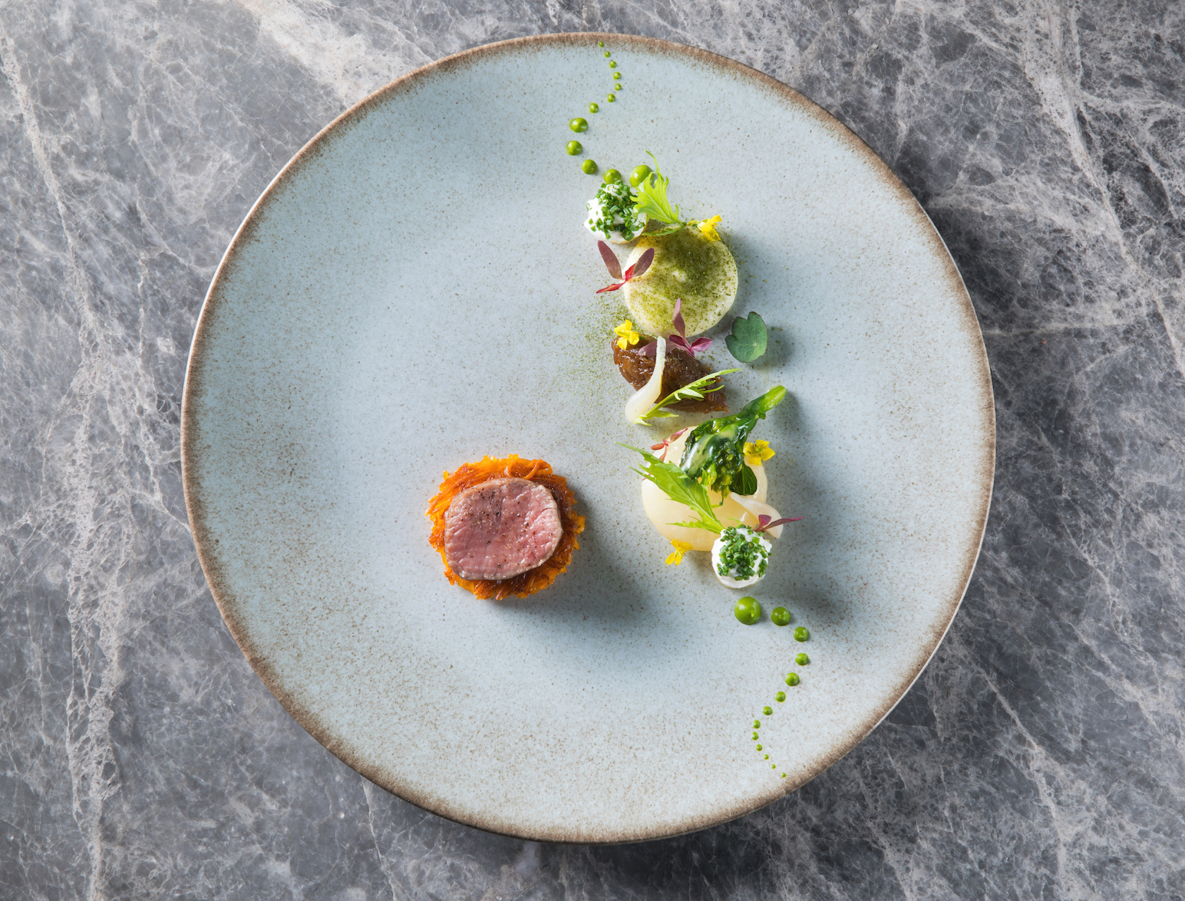
01
Practical Motivation

Slide 4
Practical Motivation
Problem definition:
The Michelin Star to most restaurant owners is the proof of success.
Is there any factors that a restaurant can adopt increase their chances of obtaining a Michelin Star?
As a 1 Michelin Star restaurant is there any factors to adopt to rise up in stars?

Slide 5
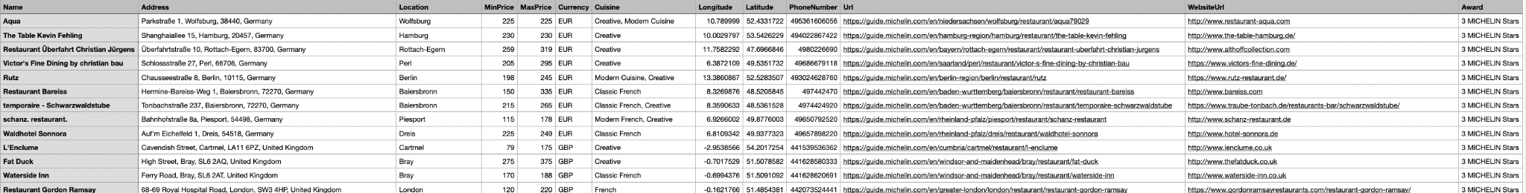
Data Set
Kraggle Data Set: Michelin Guide 2021
Data Set consists of:
13 Columns
6353 Rows
Columns include: Name, Address, Location, Currency, MinPrice, MaxPrice, Cuisine, Longitude, Latitude , Award, PhoneNumber, URL, WebsiteUrl

Slide 6
Our Motivation
Problem definition:
We want to be able to help restaurant owners reach the pinnacle of running a restaurant.
Which is why we are analysing the current michelin star restaurants and finding factors that will increase the chances of restaurants obtaining a michelin star or getting more michelin stars.
We will use various factors to predict if a restaurant has one/two/three michelin stars and what sets them apart from other restaurants.

Slide 7
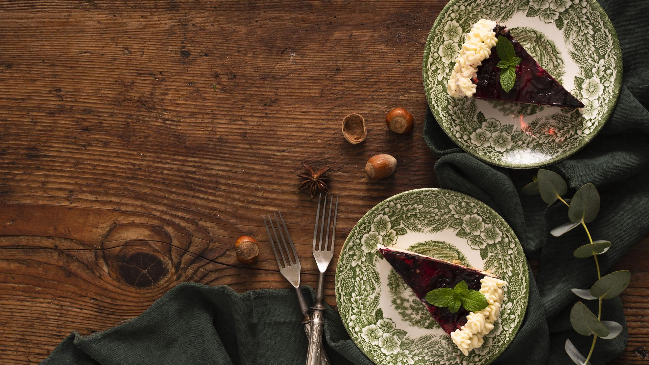
02. Data Set
Presentation

Slide 8
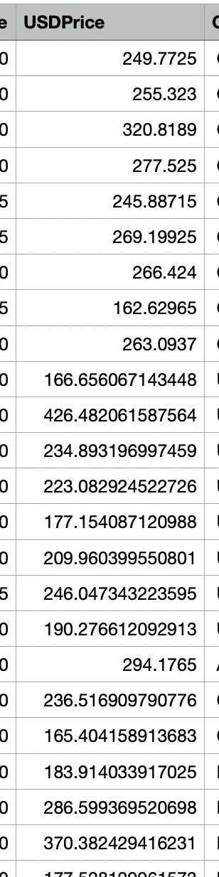



Cleaning of data set
In order to use price as a variable for prediction, we had to first have to convert the data type of MinPrice and MaxPrice to integer
Creating an extra column and using that we can obtain the mean price
Using a library “CurrencyConvertor” we convert the currency to USD
For currencies not supported by the library, we changed them accordingly using similar value currencies

Slide 9
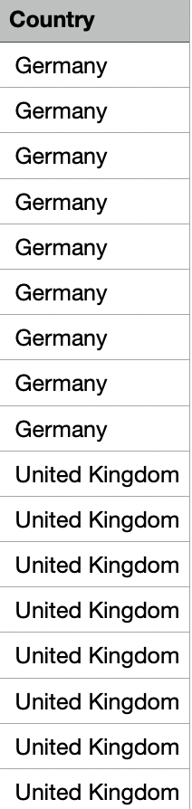

Adding countries
In order to use the country as a variable for prediction, we had to first have to obtain an additional column for country, extracting it from the address
We noticed that the country is always the last part of the string for address which was separated by “,”
We used .split(“,”) to obtain the country

Slide 10
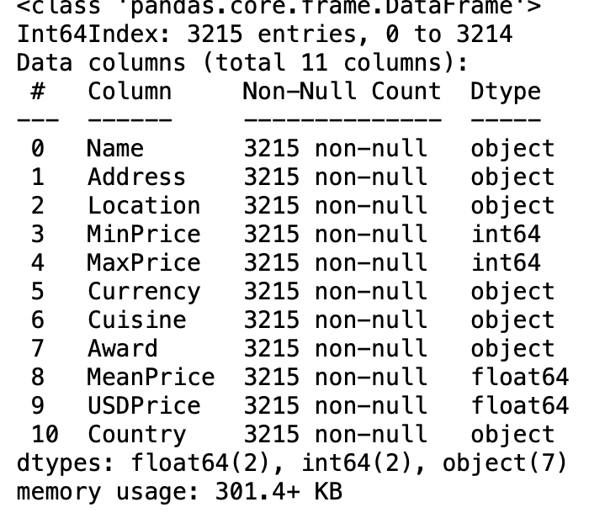
Last part of cleaning
We fixed the NAN values and dropped rows where award = “Bib Gourmand” as we are only focusing on michelin star awards.
We dropped irrelevant columns such as PhoneNumber, Url, WebsiteUrl, Longitude, Latitude.
Although other columns like location and address are ultimately not used for data exploratory analysis and machine learning, it was still useful in knowing the information
3215 rows, 11 columns
We then exported this data frame out as a csv for data exploratory analysis and machine learning

Slide 11
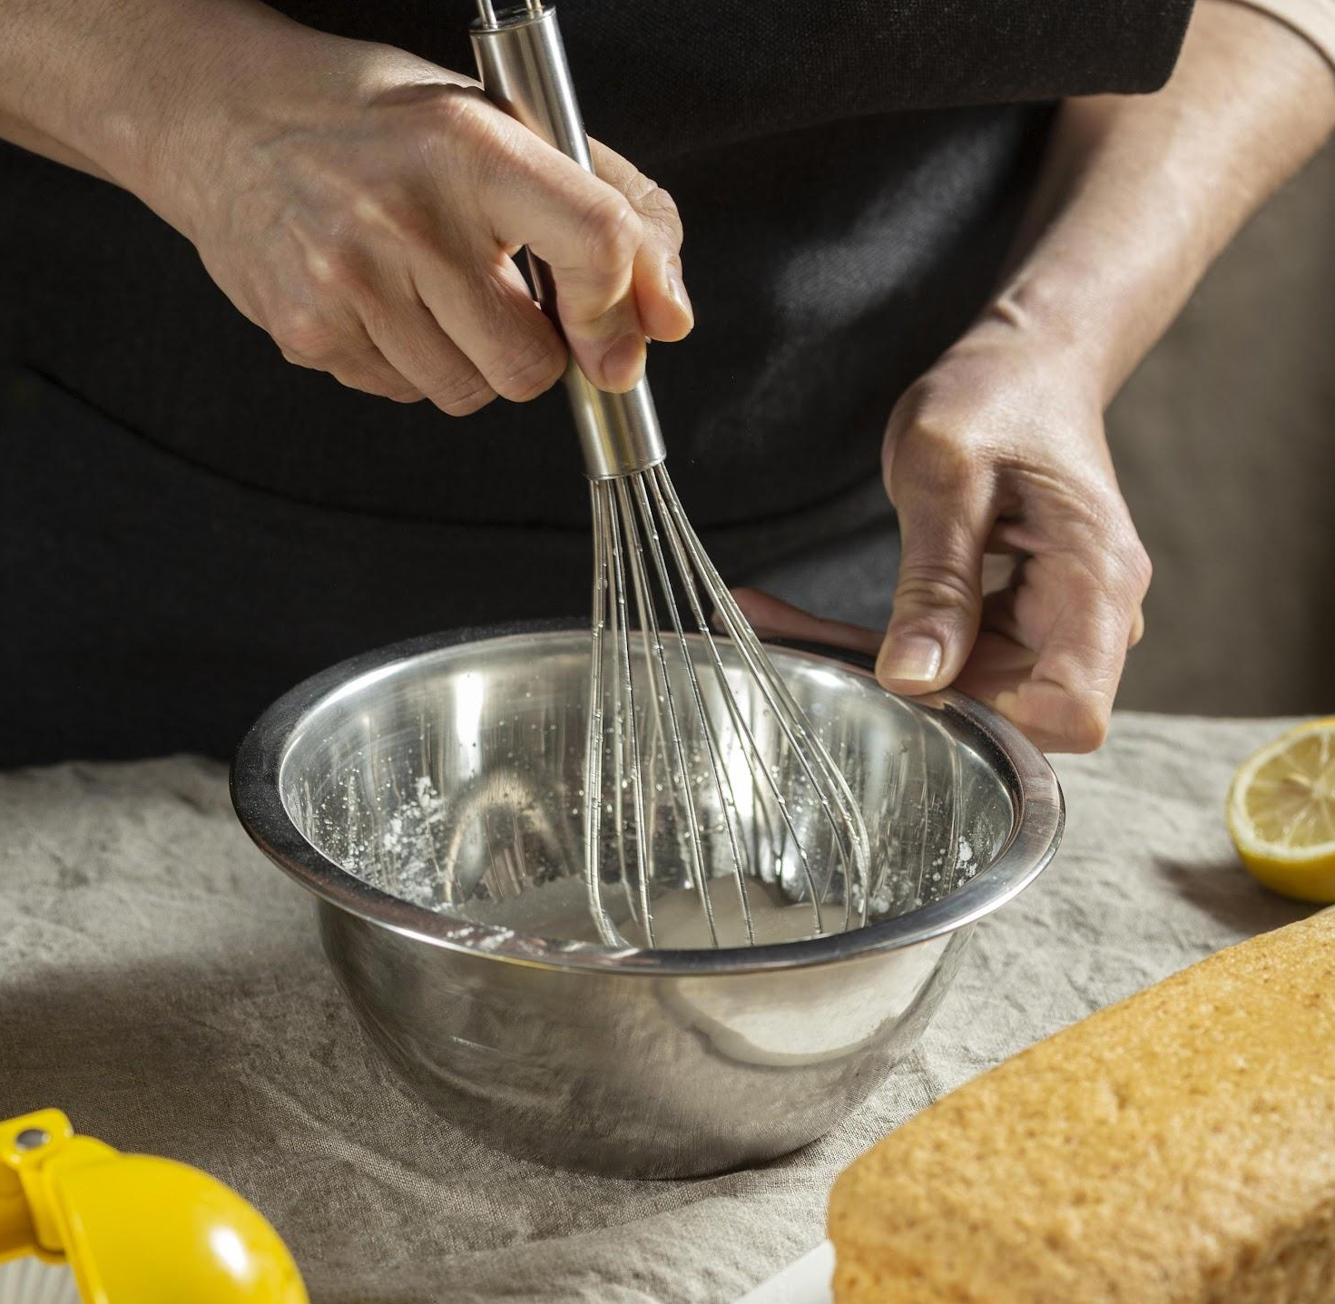

Data Exploratory Analysis
Uni-variate Analysis
Bi and Multi
Variate Analysis
Using variables of country, michelin stars, price and cuisine, we analysed the statistics.
Using variables of country and michelin stars, price and michelin stars, cuisine and michelin stars, we analysed the statistics.

Slide 12
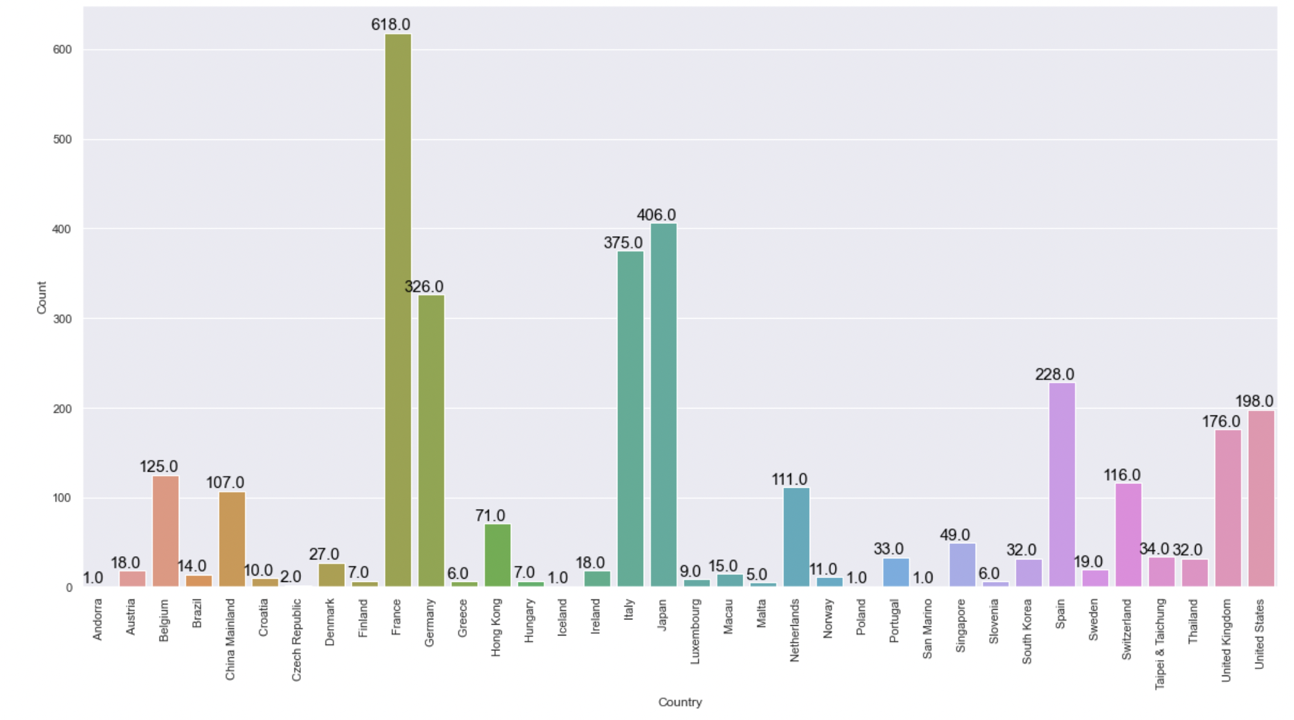
Uni-variate Analysis
Country
We managed to find the number of countries with michelin star restaurants in the world
Which countries has the most number of michelin star restaurants and their percentages
There are a total of 36 unique countries that have Michelin star restaurants.
The country with the most Michelin Star restaurant is France with 618 restaurants, taking up 19.22%.
The second country with the most Michelin Star restaurants is Japan with 406 restaurants, taking up 12.63 %
The third country with the most Michelin Star restaurants is Italy with 375 restaurants, taking up 11.66%
In the dataset of countries with Michelin Star restaurant, the countries with the least number of Michelin Star restaurants are Andorra, Iceland, Poland and San Marino with only 1 resturant.

Slide 13
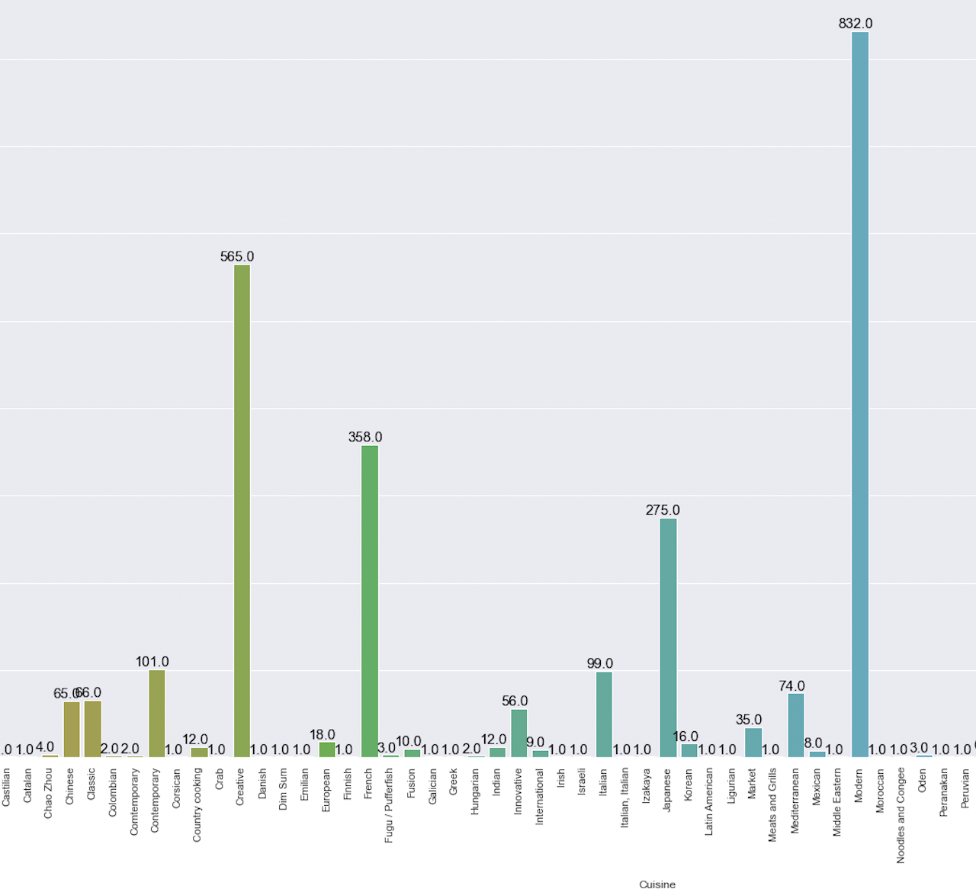
Uni-variate Analysis
Cuisines
We obtained the a list of the unique cuisines and the count for each of them.
Finding the most popular cuisines and the cuisines that are not as popular
There is a total of 98 unique cuisines.
The most popular cuisine that bags Michelin Stars is Modern with 832 restaurants, taking up 25.87%
The second most popular cuisine is Creative with 565 restaurants, taking up 17.57%
The third most popular cuisine is French with 358 restaurants, taking up 11.14%
There are many unique cuisines that only has one restaurant specialising in it, for example: African, Austrinan, Beef, Belgian, Castilian, Catalan, Crab etc.

Slide 14
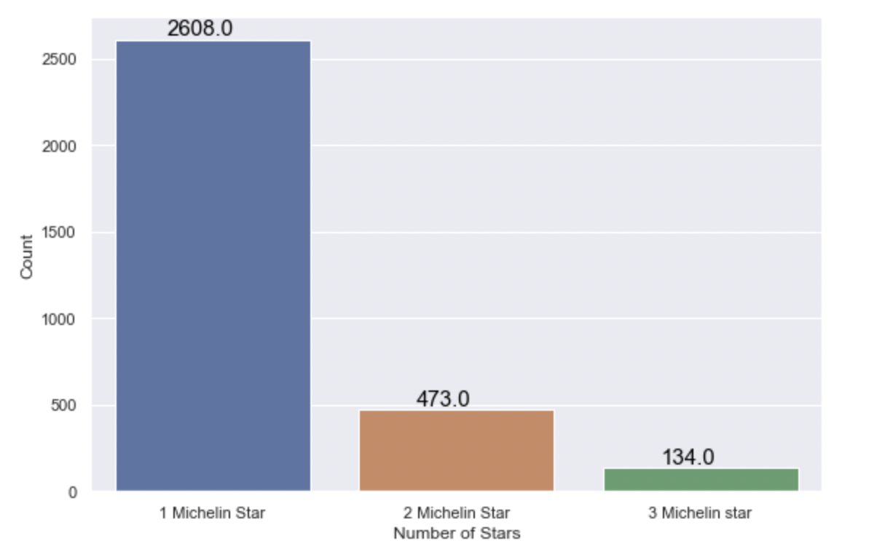
Uni-variate analysis
Michelin Stars
We found the number of 1/2/3 michelin star restaurants and their percentages
There are a total of 3215 Michelin star restaurants
There are only 134 three Michelin star restaurants
There are 473 two Michelin star restaurants
There are 2608 one Michelin star restaurants
Percentage of 3 Michelin Stars: 4.17%
Percentage of 2 Michelin Stars: 14.71%
Percentage of 1 Michelin Star: 81.12%

Slide 15
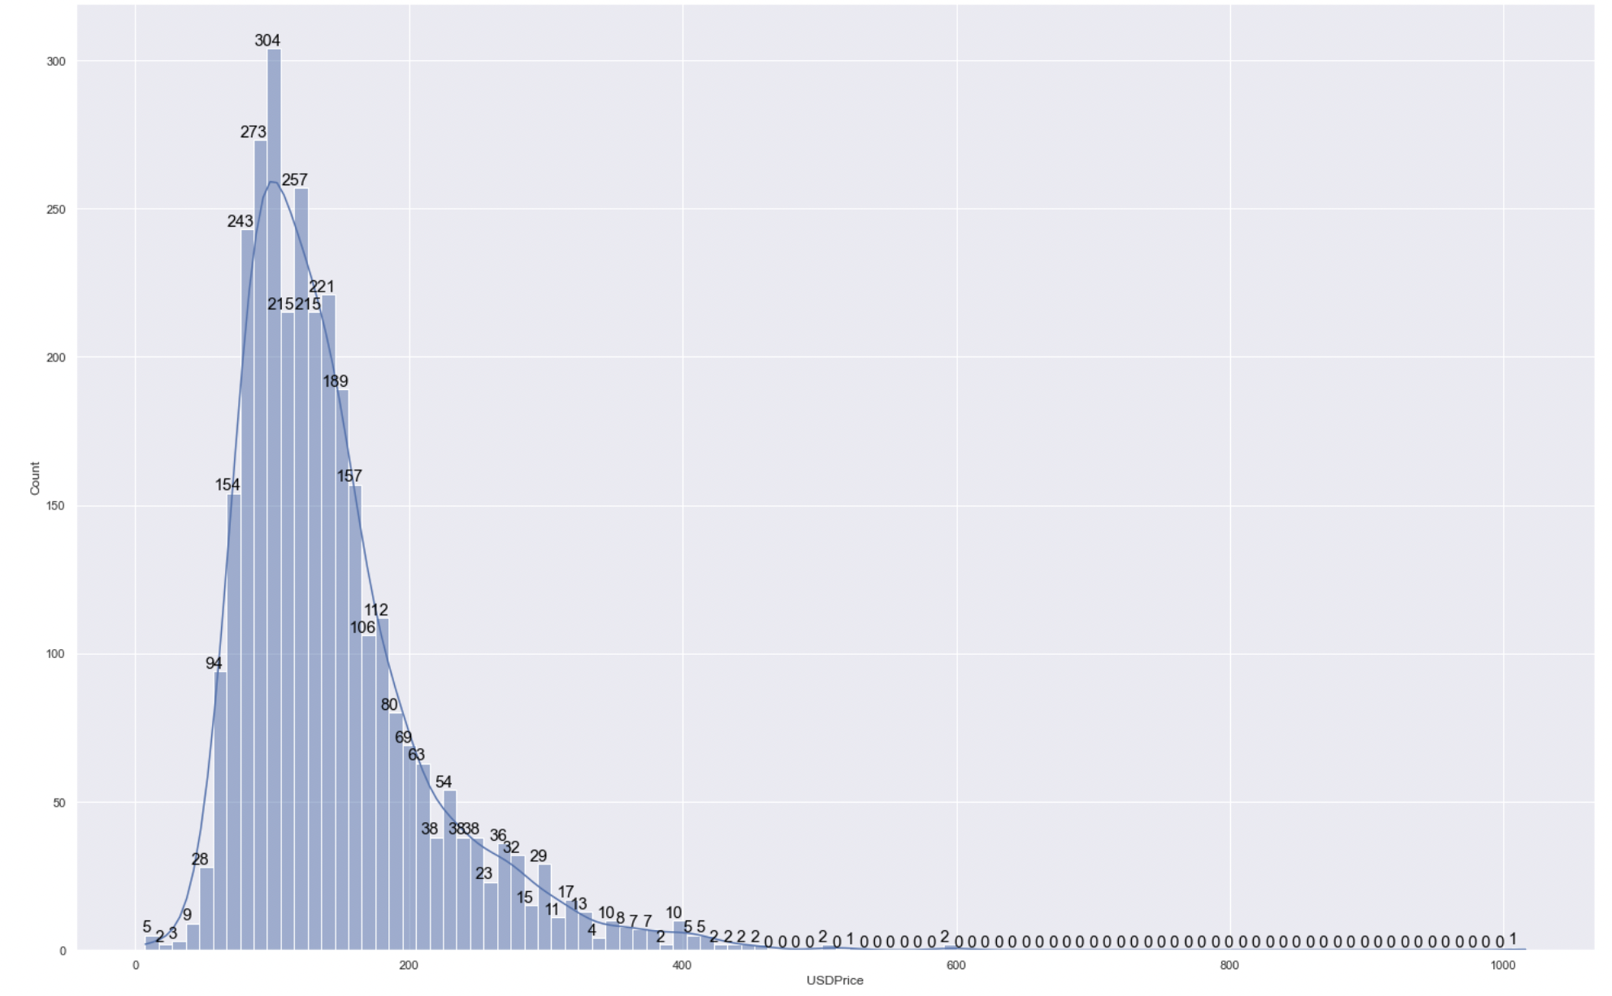
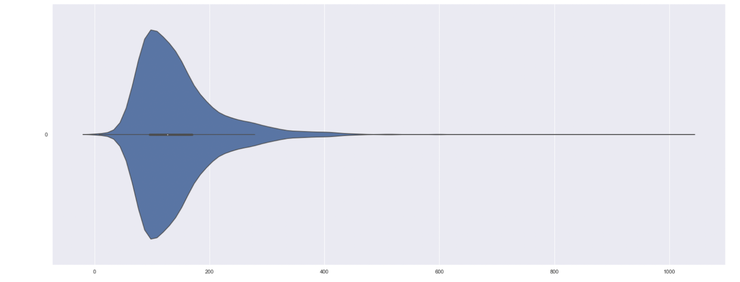
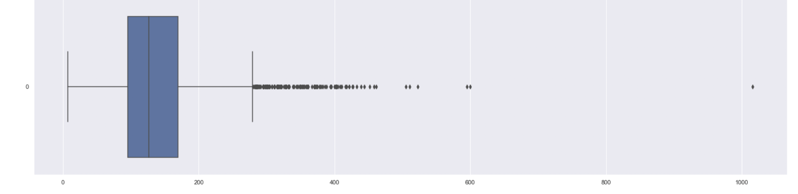
Uni Variate analysis
Mean price in USD
We plotted box plot, histogram and violin plot to visualise the the skewness, mean, standard deviation and quartiles.
Using this we are able to see the outliers and obtain the statistics based on the mean price
The mean price of dining at a Michelin Star restaurant is USD$143.78.
The cheapest price of dining at a Michelin Star restaurant is USD$7.39.
The most expensive meal at a Michelin Star restaurant is USD$1016.08.
There is a standard deviation of USD$70.73.

Slide 16
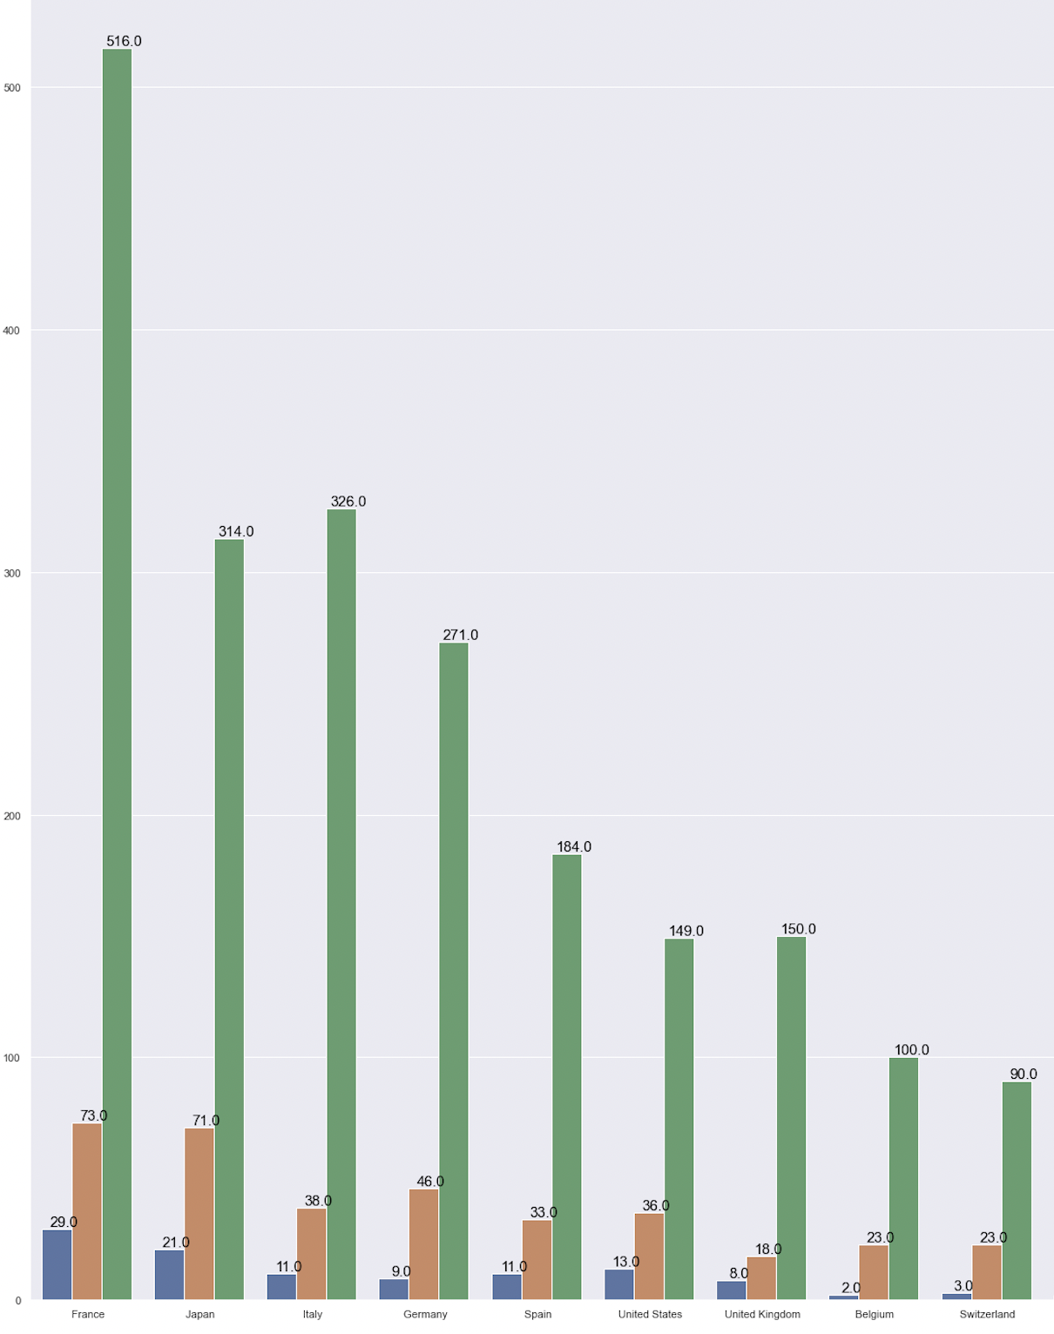
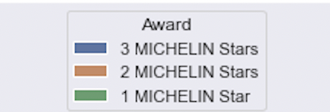
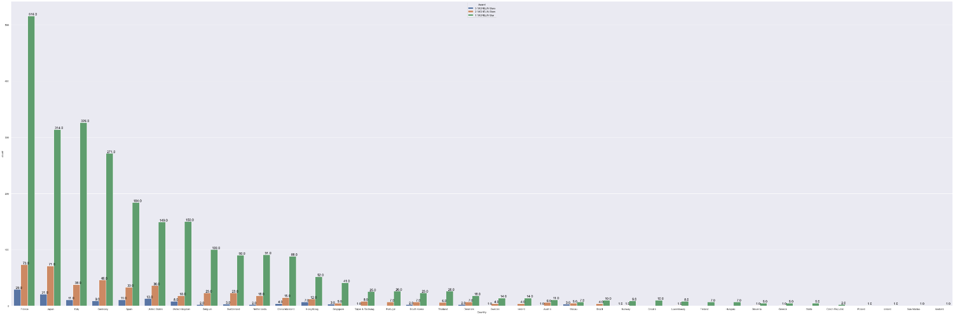
Bi-variate Analysis
Country and Michelin Stars
We are able to plot the bar graph showing countries divided into 1/2/3 michelin stars and obtain the following statistics:
The country with the most 3 michelin star restaurant is: France with 29 followed by Japan with 21 and Italy with 11
The country with the most 2 michelin star restaurant is: France with 73 followed by Japan with 71 and Italy with 38
The country with the most 1 michelin star restaurant is: France with 516 followed by Italy with 326 and Japan with 314

Slide 17
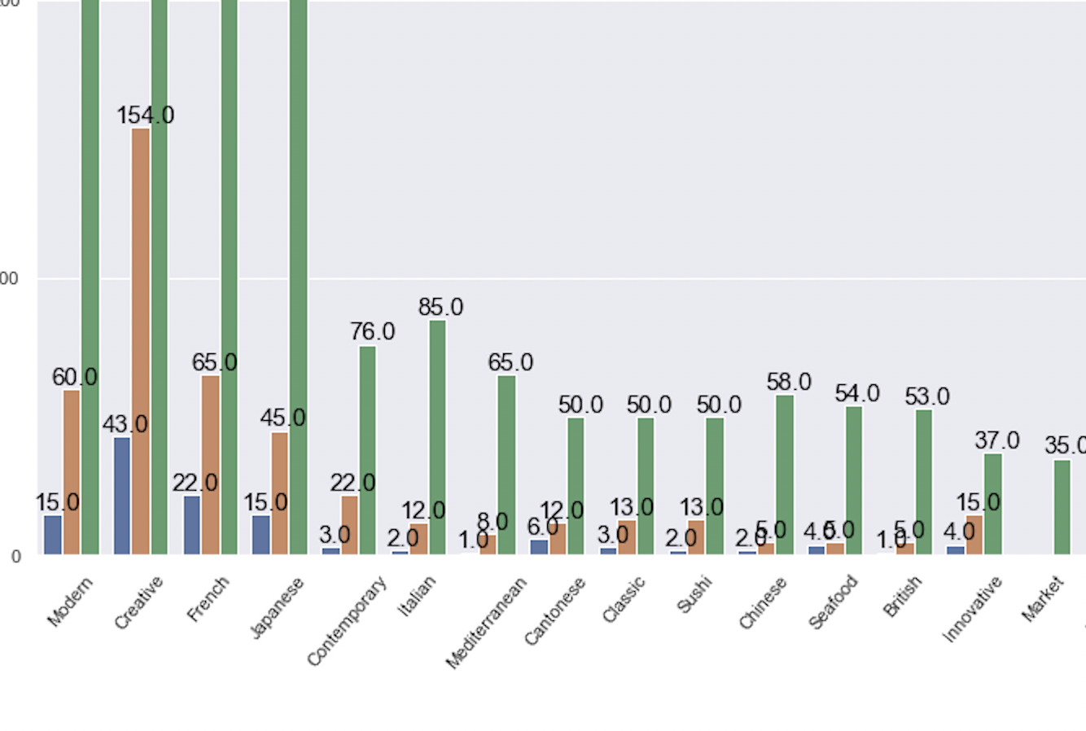
Bi variate Analysis
Cuisine and Michelin Stars
We are able to plot the bar graph diving the cuisine categories intro their respective michelin stars and obtain the following statistics:
The cuisine with the most 3 michelin stars is: Creative with 43, followed by French with 22, and a tie between Modern and Japanese with 15
The cuisine with the most 2 michelin stars are: Creative with 154, followed by French with 65 and Modern with 60
The cuisine with the most 1 michelin star are: Modern with 757, followed by Creative with 368 and French with 271

Slide 18
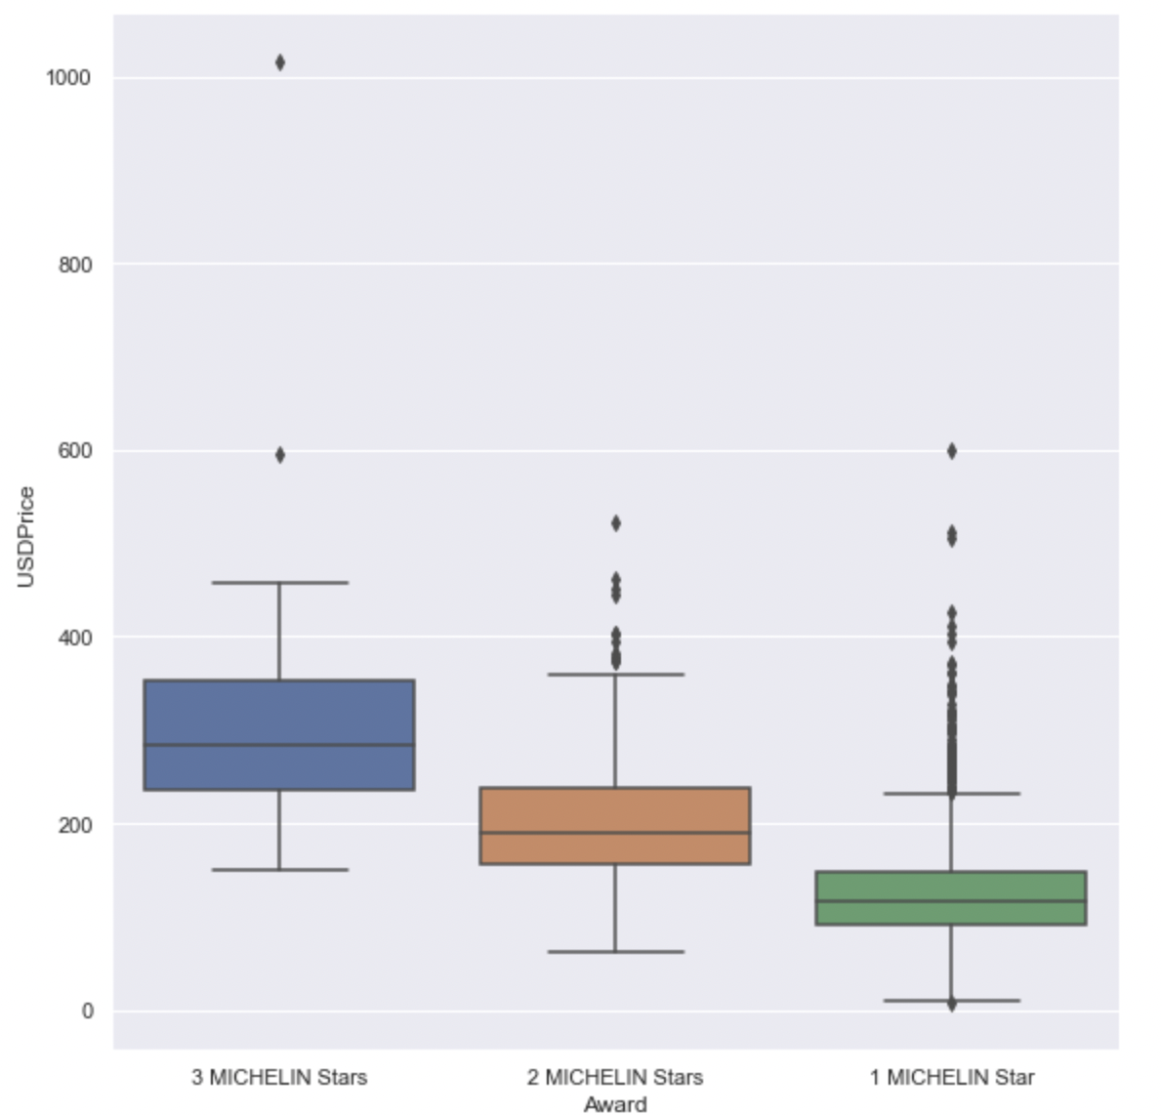
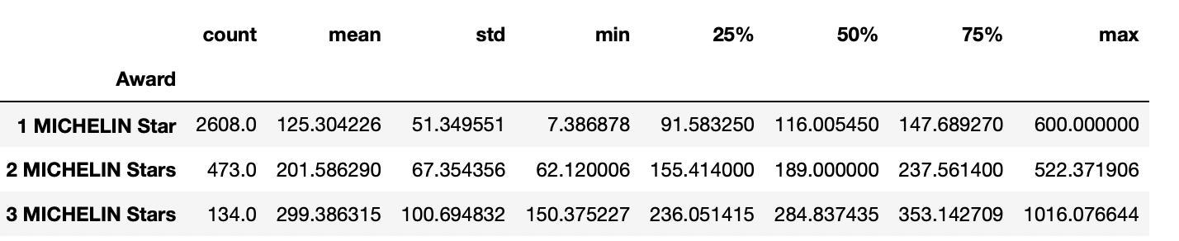
Bi-Variate Analysis
Mean price in USD and Michelin Stars
We managed to plot a catplot based on the number of michelin stars and the numeric data of mean price and obtained the following statistics:
There are a total of 134 three star michelin restaurants, the highest price is 1016.08 USD, while the cheapest is 150.36 USD. The mean price of dining at a three michelin star restaurant is 299.38 USD.
There are a total of 473 two star michelin restaurants, the highest price is 522.37 USD, while the cheapest is at 62.12 USD. The mean price of dining at a two michelin star restaurant is 201.59 USD.
There are a total of 2608 one michelin star restaurants, the highest priced at 600.00USD, while the cheapest is at 7.38USD. The mean price of dining at a one michelin star restaurant is 125.30USD.

Slide 19
Machine Learning
We chose machine learning techniques that is used for classification. As there is alot of data with multiple features to calculate which makes it a suitable problem for machine learning. We mainly used two models using the variables, country, cuisine and price to predict the michelin star numbers.
Decision Tree Classification
Support Vector Classification
Separating the data set into train and test sets, appending the necessary columns and plotting out the confusion matrix for the model.
Obtain the Goodness of fit and the classification accuracy
We chose Support vector classification to see how Ordinal Encoding affects the accuracy of the data

Slide 20
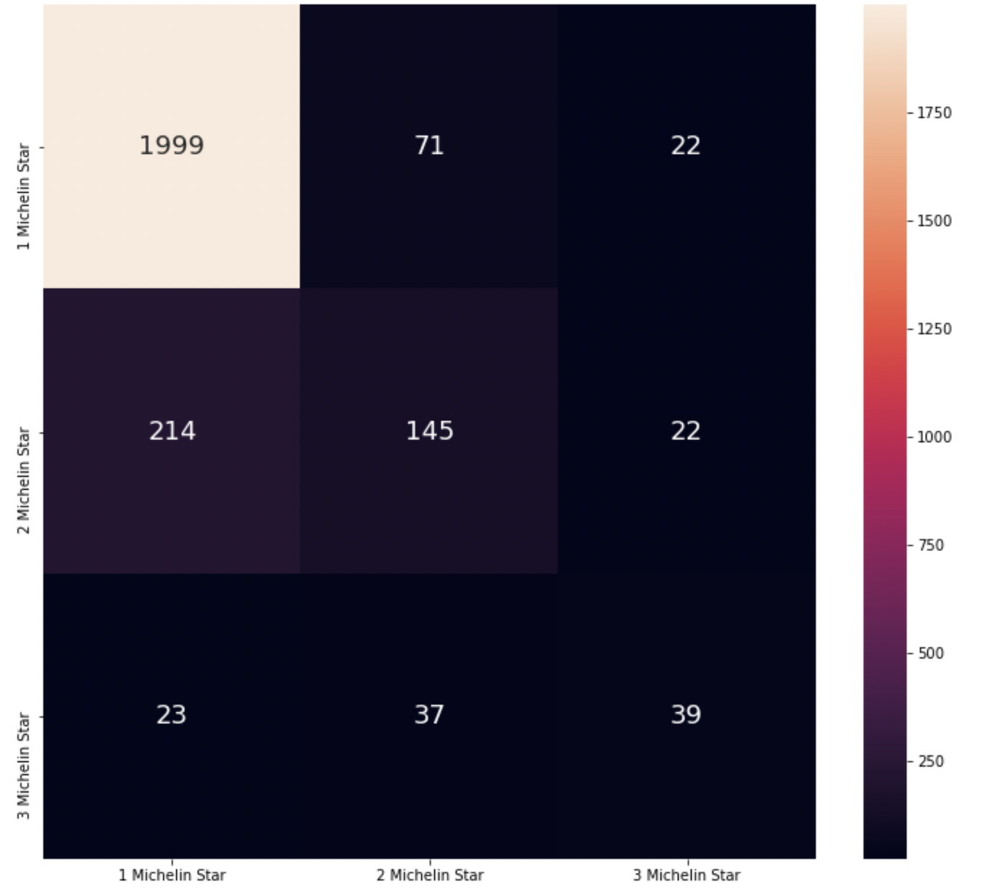
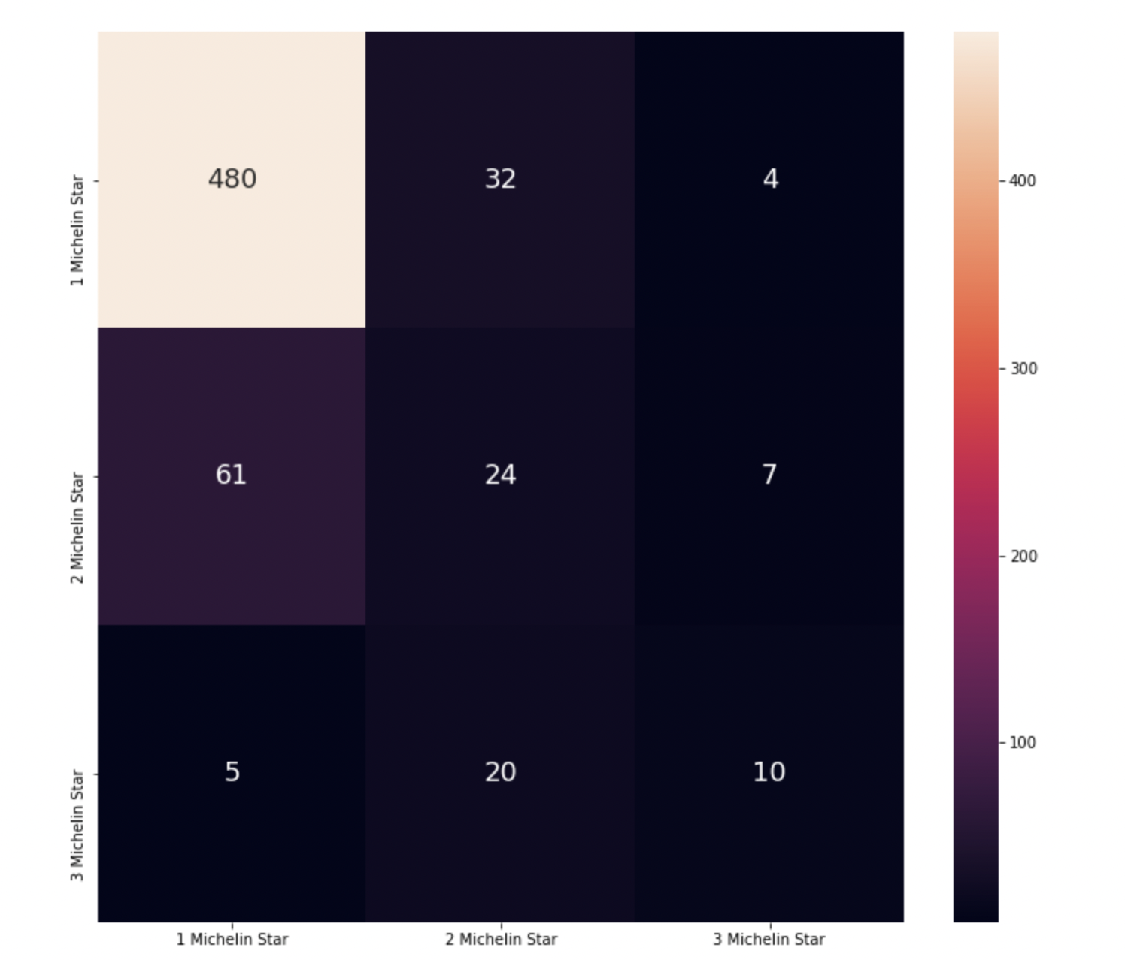
Machine Learning - Decision Tree Classification
By modeling using the decision tree classification model, we obtained the following statistics:
Goodness of Fit of Model Train Dataset
Classification Accuracy : 0.8359253499222395
Goodness of Fit of Model Test Dataset
Classification Accuracy : 0.8351477449455676

Slide 21
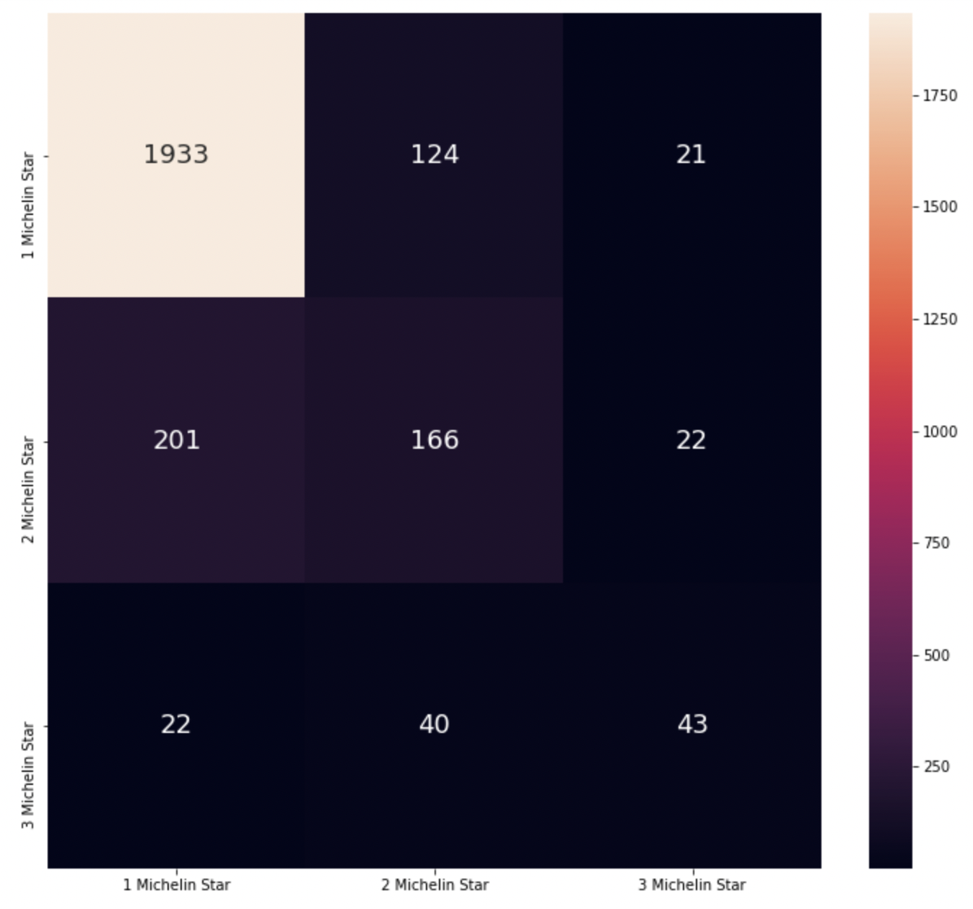
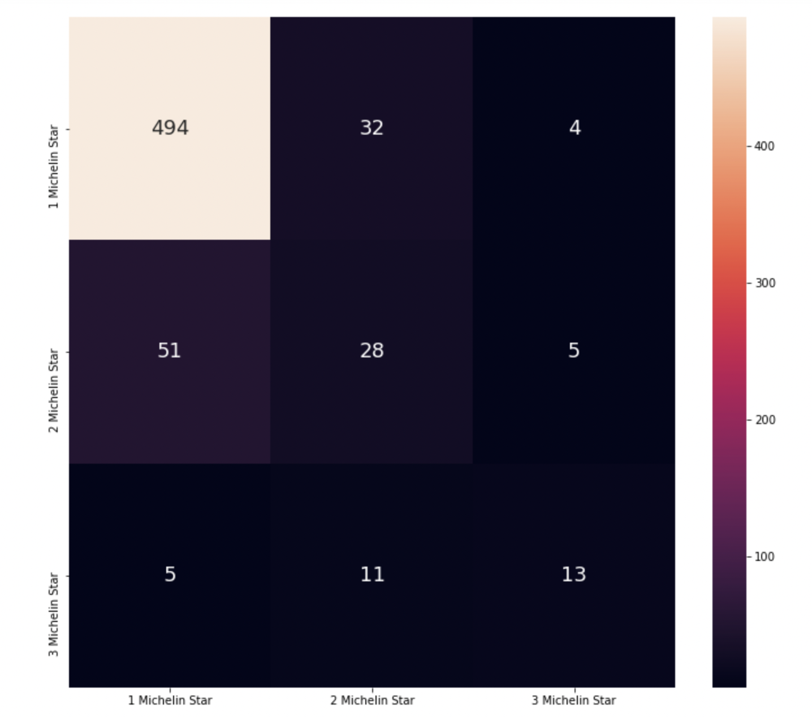
Machine Learning - Support vector classification
By using the SVM library for SVC, it classifies each datasets as a vector and find a line or hyperplane that can have a biggest separation between two classes.
By using Support vector classification it would be more possible to increase the accuracy of the model in predicting the number of michelin stars.
Below are the statistics obtained from the support vector classification and its confusion matrix.
Goodness of Fit of Model Train Dataset
Classification Accuracy : 0.8328149300155521
Goodness of Fit of Model Test Dataset
Classification Accuracy : 0.8320373250388803

Slide 22
Machine Learning
Both of the Decision Tree Classification and Support Vector Classification had similar accuracy, about 0.8. For the Support Vector Classification, it would be also possible to explore using one-hot encoding to change the categorical data for possible increase in accuracy, but for this dataset it would be too complicated to use, therefore not used in this classification problem.
Through this model we can conclude that by using the type of cuisine, mean price of a meal at the restaurant and the country of the restaurant, we can predict how the restaurant should approach to obtain a michelin star. It could be focusing on a different type of cuisine or using ingredients that match the price point.

Slide 23
04. Conclusion
Our recommendations:
- From our uni-variate analysis on countries, cuisines, there is a higher chance of getting a michelin star if the restaurant is in France, focusing on Modern cuisines. The prices should be set around USD143.78.
- From our bi-variate analysis on countries with award, cuisine with award and price with award, we concluded that generally stationing the restaurant in France will have a higher chance of getting a michelin star.
- Focusing on modern cuisines will have a higher chance of getting a michelin star, however, switching to a Creative cuisine will warrant higher chances of getting two and three michelin stars.
- The price of dining generally increases as the number of michelin star increases

